Slide 1
ID KA210-YOU-7B9F0FFA
Laboratory for Youth Social Entrepreneurship "Hot Zone"
Laboratory for Youth Social Entrepreneurship
"Hot Zone"
01/03/2022 24 01/03/2024
60000 Eur

Slide 2

YothHotZone...
Development of the capacity of the partner organizations
Laboratory for Youth Social
Entrepreneurship "Hot Zone"
GOALS
CreatIion of a Laboratory for Youth Social Entrepreneurship

Slide 3
YothHotZone...
Analysis of the practices of social entrepreneurship
Laboratory for Youth Social
Entrepreneurship "Hot Zone"
SUBgoals
Tools for training and consulting on social entrepreneurship
Laboratory for Social Entrepreneurship
Improving the capacity of the partner organizations

Slide 4

YothHotZone...
Model for social entrepreneurship development /METHODOLOGY
PRODUCTS
Handbook for followers
Training instrument
Laboratory for Social Entrepreneurship & online platform

Slide 5
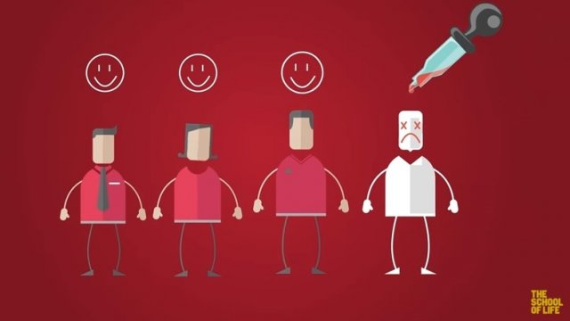
YothHotZone...
Model for social entrepreneurship development /METHODOLOGY
ACTIVITIES
Development of tools for training in social entrepreneurship +multimedia
"The essence of social entrepreneurship" “Areas of application and resourcefulness of social entrepreneurship”
"Good practices in social entrepreneurship“
Career "Social Entrepreneur"
Establishment of a Laboratory for Social Entrepreneurship & online Platform
Concept; Structure/ Interface; Software; Upload to Server
Trainings

Slide 6

YothHotZone...
Leantick ltd. (Bulgaria)
Laboratory for Youth Social
Entrepreneurship "Hot Zone"
PARNERS
Black Sea Institute Association (Bulgaria)
FUNDACJA INSTYTUT EUROPEJSKI (Poland)

Slide 7


YothHotZone...
Activity 1, responsible partner P3 participating partners P1,P2
30/06/2022 - 30/04/2023
Laboratory for Youth Social
Entrepreneurship "Hot Zone"
Activity 2 responsible partner P1, participating partners P1,P3
01/07/2022 - 31/07/2023
Partnership arrangement
Activity 3, responsible partner P2, participating partners P1, P3
31/07/2022 - 30/01/2024
Activity 4, responsible partner P1 participating partners P2,P3
01/08/2023 - 01/12/2023

